Slide 1
Meeting – 19/6/2022
Compressible boundary layers
Stability of compressible boundary layers, Inviscid
Generalized inflection point
Mack modes, neutral
Mack modes, unstable
Additional reading
Leslie M. Mack – AGARD Report N. 709,p. 3 (1984) Boundary Layer Linear Stability Theory, link

Slide 2
Compressible boundary layers
In compressible flow, the boundary layer equations are

Slide 3
Compressible boundary layers
Introducing similarity transformation,
and defining a streamfunction
we get (assuming zero-pressure-gradient)

Slide 4
Compressible boundary layers
The boundary conditions for the similarity equations
On the wall
Freestream

Slide 5
Compressible boundary layers
The coupled ODE’s are solved, adiabatic case:

Slide 6
Compressible boundary layers
The coupled ODE’s are solved, isothermal (cold wall) case:

Slide 7
Generalized inflection point
A necessary and sufficient condition for the existence of a neutral subsonic wave is that there is some point y_{s}>y_{o} in the boundary layer where and y_{o} is the point at which U=1-1/M, the wave phase velocity is c_{s}=U(y_{s})
A sufficient condition for the existence of an unstable wave is the presence of a generalized inflection point at some y>y_{o}
This is a generalization of the Rayleigh criterion (incompressible)

Slide 8
Illustration of GIP and sonic point
Sonic wave, travels with u=1/M GIP: d(ρ du/dy)/dy=0
(speed of sound) relative to edge
y_{s}
y_{o}
y_{o}
1/M

Slide 9
Phase velocities of neutral inflectional and sonic waves
Neutral waves, GIP
subsonic @ edge
supersonic @ wall
sonic wave, c=1-1/M
supersonic
Neutral waves are subsonic relative to edge
subsonic
wall speed of sound
supersonic @ edge
subsonic @ wall

Slide 10
Mack modes
Inflectional neutral waves
These are waves with ω_{i}=0 and u_{ph}=c_{s}
Note each eigenvalue on this figure has different α, for all of them ω/α=c_{s}

Slide 11
Mack modes
Inflectional neutral waves
The mode number is N_{zero-crossings} – 1
All modes decay at infinity
1st
4th
3rd
2nd

Slide 12
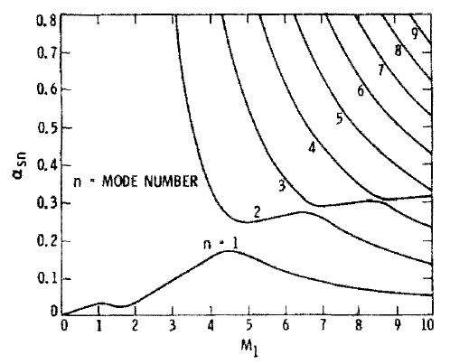
Mack modes
Inflectional neutral waves, effect of Mach number

Slide 13
Mack modes
Unstable waves, two-dimensional
2nd
1st

Slide 14
Mack modes
Unstable waves, two-dimensional, growth rate
2nd mode

Slide 15
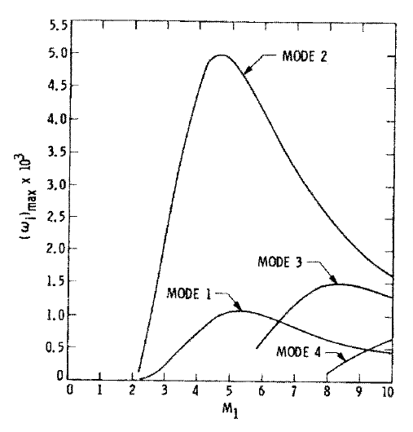
Mack modes
Unstable waves, two-dimensional, effect of Mach number
2nd mode most unstable
3rd mode sometimes more unstable than 1st mode

Slide 16
Mack modes
Unstable waves, three-dimensional
Most unstable 1st mode is oblique
1st
Higher modes - 2D most unstable
2nd

Slide 17
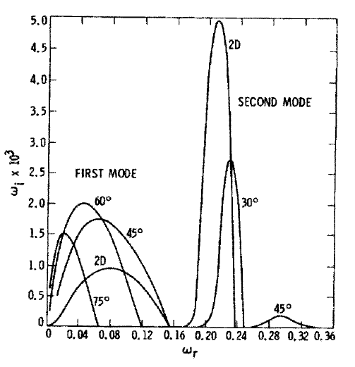
Mack modes
Unstable waves, three-dimensional, various wave angles, θ=atan(β/α)

Slide 18
Mack modes, summary
Inviscid instability mechanism (GIP)
2nd mode is the most unstable one, sometimes referred to as a ‘pressure wave trapped in the boundary layer’ (debated, use with caution)
1st mode is the compressible counterpart of the Tollmien-Schlichting viscous mode for M=0 (note former is compressible-inviscid while latter is incompressible-viscous)
Most unstable 1st mode is oblique (note Squire theorem for incompressible is not applicable)
Extension to viscous regime – viscosity has a stabilizing effect on the inviscid instabilities

